Slide 1

Machine Learning Fundamentals

Slide 2
Machine Learning Introduction
Python Introduction

Slide 3
Probability and Statistics for Machine Learning
Distributions in Machine Learning
Machine Learning Optimization

Slide 4
All source files provided!

Slide 5
Requirements

Slide 6
No coding experience required
No math experience required

Slide 7

Python introduction included

Slide 8
No installation required
No paid software required

Slide 9
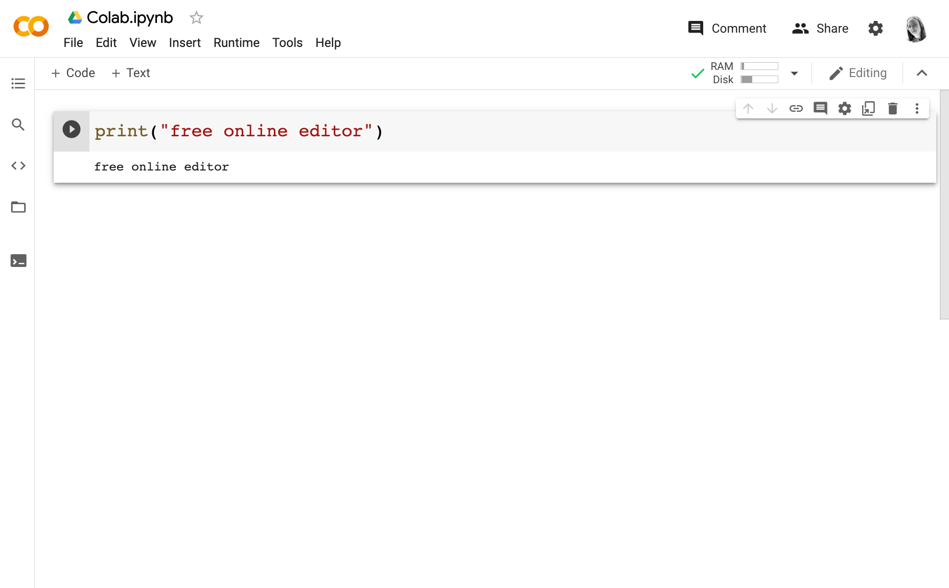
Code editor with Python support
Free online: Google Colab
https://colab.research.google.com
Or on your computer

Slide 10
Working with Google Colab
Variable values can get stuck.
If your changes don’t seem to update, restart the runtime.

Slide 11
How to Debug
Search your bug, problem or question via a search engine
Many answers on Stack Overflow
Join a Discord server

Slide 12
How to Debug
Visit the Github for the library that isn’t working
Visit the documentation for what you are struggling with

Slide 13
Machine Learning Fundamentals

